Slide 1
Module 3
Innovation - Documentation
Part 2

Slide 2
An invention is a new and significant technical solution to a problem in any sector of a national economy, socio-cultural construction or national defense, which gives a positive effect.
Invention
Device
Way
Substance
Strains of microorganisms

Slide 3
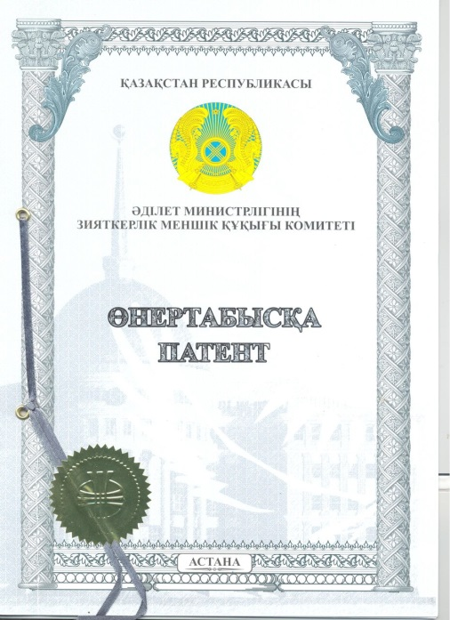
Patent - a certificate issued by a competent state authority (a security certificate) certifying recognition of a technical solution or a selection achievement as an invention, priority of an invention (primacy), authorship (not in all countries) and the exclusive right of the patent owner to the invention within the territory of the state that issued the patent for term established by the legislation of this state.
Patent protects form a not content !!!

Slide 4
Patentability criteria
Innovation should be:
New
Unobvious
Applicable in production

Slide 5
Examples

Slide 6
Patent of the Russian Federation - Method for reducing the moisture content of a vacuum disk filter cake when removing a cake by stripping with compressed air
The invention is intended for the dewatering of suspensions and can be used in ferrous and nonferrous metallurgy, as well as in chemical, coal and other industries that use vacuum disk filters.
Implementation of the invention will reduce the degree of secondary moistening of the cake when it is removed from the sectors of the disk vacuum filter by the method of Stripping and will allow without additional energy to reduce the humidity of the resulting product (concentrate) and / or increase the performance of the vacuum filter cake by stripping with compressed air.

Slide 7
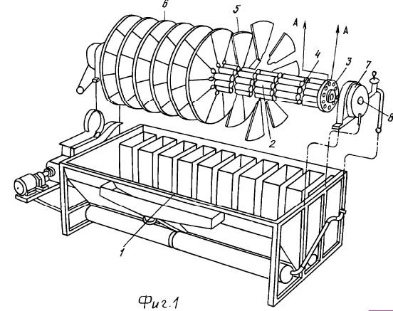

Slide 8
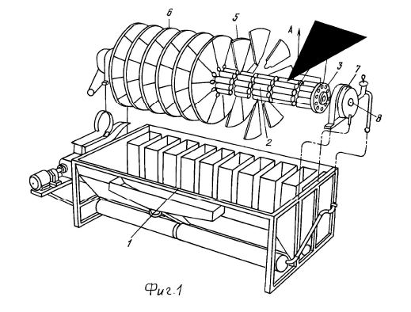
The expert is assigned the task - presumably on based on the drawings, copied a similar device that performs similar functions.
Question: Is there a violation? (Copy the detail indicated by the arrow)

Slide 9
CONCLUSION:
A patent protects a method, not a device. Accordingly, it is necessary to confirm that there is a violation of the method. The similarity of the devices does not imply a violation of this patent.
BUT ... it is known that they were registered three patents. We have considered one of them. The other two protect, just - the device.

Slide 10
Example 2
Given:
utility models № 73365 and number 96143

Slide 11
№ 73365
FRAME BUILDING RIGEL
The crossbar of the frame building comprising a wall and a shelf located in the lower part, characterized in that it is made prefabricated and monolithic, while the shelf has a tray-like shape, and the wall is made in the form of a primitive reinforced concrete belt, the lower part of which is placed in the shelf of the shelf etc.

Slide 12
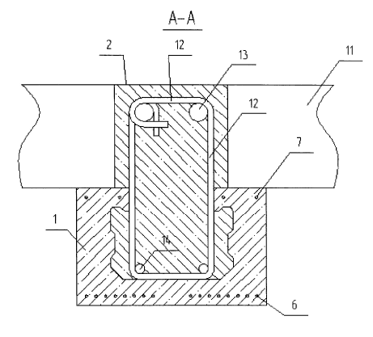
One of the illustrations

Slide 13
№ 96143
FRAME OF BUILDINGS AND CONSTRUCTIONS
The frame of buildings and structures containing reinforced concrete columns with openings in the level of floors, reinforced concrete bolts rigidly mated with each other, and floor slabs, characterized in that the bolts are made prefabricated monolithic in the form of spatial bodies with a pre-stressed pre-stressed lower part , on the inner surface of which there is at least one wedge-shaped protrusion, and with the upper part in the form of a monolithic reinforced concrete belt, the lower part of which is placed in a tray, and top - between the ends of the plates.

Slide 14
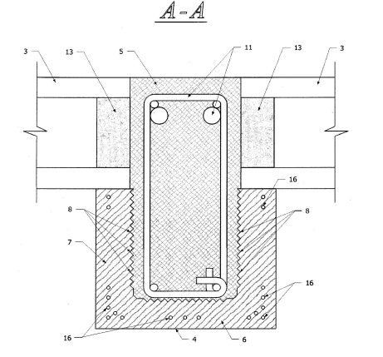
The court won the defendant !!!

Slide 15
License agreement

Slide 16
The means of "disposition of the exclusive right"; A civil contract whereby “one party - the holder of an exclusive right to the result of intellectual activity or to a means of individualization (licensor) - grants or undertakes to give the other party (licensee) the right to use such a result or means within the limits provided by the sample license agreement”. Therefore, copyright, patent, related and other rights may be granted in the license agreement.

Slide 17
Contract example
Definition of terms
1.1. Agreement - this license agreement.
1.2. Patent - patent for utility model No. 84750 "Tie dowel”, authors: V. Gluschenkov, F. Grechnikov.
1.3. Intellectual performance - useful model protected by patent.
1.4. Technical documentation - design, technological, operational, software, regulatory or other documentation.
1.5. Products under license - products that will be produced as a result of using the results of intellectual activity.

Slide 18
2. Subject of the Agreement
2.1. The licensor has exclusive rights to the results of intellectual activity. The licensee wishes to acquire under the terms of this Agreement a license to use the results of intellectual activity.
2.2. The Licensor grants the Licensee for the term of this Agreement in the territory of the Agreement for a fee paid by the Licensee a license to use the utility model protected by a patent.
2.3. The scope of rights granted is a non-exclusive license.
2.4. The Licensor does not grant the Licensee the right to issue sublicenses to third parties.

Slide 19
3. Rights and obligations of the Licensee
3.1. The licensee may use the results of intellectual activity only to the extent of those rights and in the ways provided for by this Agreement.
3.2. The Licensee undertakes to manufacture (use) the Products under license in full compliance with the received Technical Documentation.
3.3. The licensee shall pay the remuneration in the manner and on the conditions provided for in paragraph 5 of the agreement.
3.4. The Licensee shall not have the right to produce, offer for sale and sell the Products under a license outside the Territory without the prior consent of the Licensor.

Slide 20
4. Rights and obligations of the Licensor
4.1. The licensor has the right to monitor the compliance of the Licensee with the fulfillment of the terms of the Agreement, the obligations assumed and monitor the progress of work.
4.2. The licensor is entitled to receive provided for in paragraph 5. Contract reward.
4.3. During the term of the Agreement, the Licensor shall refrain from any actions that may impede the implementation by the Licensee of the right granted to use the Results of intellectual activity within the limits established by this Agreement.

Slide 21
5. Remuneration
5.1. The contract is on a reimbursable basis.
5.2. The amount of remuneration is established by the Supplementary Agreement.
6. Territory of the Agreement
6.1. The territory of the Agreement is the territory Russian Federation.
7. Contract time
7.1. The contract is for a period of 5 years.

Slide 22
8. Technical documentation
8.1. All technical documentation is transferred by the Licensor. Licensee within 10 (ten) days from the date of signing of this Agreement.
8.2. The licensee may reproduce the Technical Documentation for their needs, but subject to confidentiality obligations.
9. Plan for the practical application of the results of intellectual activity.
9.1. Production plan for production under license:
creation of a prototype;
bringing to the stage of practical application;
completion of technical documentation;
bringing to the stage of commercial production.

Slide 23
10. The procedure and deadlines for reporting on the implementation of the plan for the practical application of the results of intellectual activity.
10.1. Reporting on the implementation of specific items of the plan for the practical application of the results of intellectual activity is provided within 30 (thirty) days after completion of the work.
10.2. The Licensee provides the Licensor with summary accounting data on the volume of production and sales of the Products under a license, information about the sales prices for the Products under a license.
10.3. The licensor, either alone or through an auditor, has the right to inspect the state of production and sales of the Products under a license, to verify the specified accounting data. The licensee is obliged to ensure the possibility of such verification.

Slide 24
11. Improvements and improvements
11.1. During the term of the Agreement, the Parties undertake to immediately inform each other about all the improvements and improvements they have made regarding the results of intellectual activity of the Products under license.
11.2. The exclusive rights to protected or claimed improvements and enhancements, as well as improvements and enhancements of special value, which are created by the Licensor / Licensee, belong to the Licensor / Licensee.
11.3. Transfer of technical documentation to non-patentable Improvements and improvements will be made by the Parties under the following conditions: - free of charge; - within 10 (ten) days from the date of signing the Supplementary Agreement on the transfer of Technical Documentation to this Agreement.

Slide 25
12. Guarantees and liability of the Parties
12.1. The licensor guarantees that at the time of signing the contract is the owner of the rights to the results of intellectual activity, as well as all rights certified by the Patent.
12.2. The Licensor warrants that at the time of the entry into force of this Agreement, the Licensor is not aware of the rights of third parties that may have been violated by the granting of this license.
13. Dispute resolution
13.1. In the event of a dispute between the Licensor and the Licensee on matters covered by this Agreement or in connection with it, the Parties will take all steps to resolve them by negotiation among themselves.
13.2. If it is impossible to resolve these disputes by negotiation, they should be resolved in court.

Slide 26
14. Terms of changes and termination of the contract
14.1. The contract may be amended or terminated by agreement of the parties.
14.2. Any changes and additions to this Agreement are valid only if they are made in writing and signed by authorized representatives of the Parties.
14.3. Each of the Parties will notify the other party in writing of the intention to amend or early terminate the Agreement, if the other party does not fulfill any condition of the Agreement. The non-fulfilling party will be given 30 (Thirty) days to eliminate violations.

Slide 27
15. Force majeure
15.1. The Parties are exempt from liability for failure to fulfill or improper fulfillment of their obligations under this Agreement in the event of force majeure circumstances that directly or indirectly impede the execution of this Agreement, that is, circumstances that are independent of the will of the Parties could not be foreseen by them at the time of conclusion of the Agreement and prevented by reasonable means at their occurrence.
15.2. The circumstances referred to in paragraph 15.1 of the Treaty include: war and hostilities, uprising, epidemics, earthquakes, floods, acts of the authorities directly affecting the subject of this Treaty, and other events that the competent court recognizes and declares cases of insuperable force.

Slide 28
15.3. The party subjected to such circumstances shall immediately notify the other Party in writing of the occurrence, type and possible duration of the relevant circumstances.
15.4. The onset of the circumstances provided for in this article, subject to the requirements of clause 15.3 of this Agreement, extends the period of performance of contractual obligations for a period that generally corresponds to the validity of the circumstances and a reasonable period for its elimination.
15.5. If the circumstances stipulated by this article last more than 6 (Six) months, the Parties will jointly determine the further legal fate of this Agreement.

Slide 29
16. Confidentiality
16.1. The Parties undertake obligations to maintain confidentiality in relation to the terms of this Agreement, Technical Documentation, as well as in relation to any information about the activities of the Parties to the Agreement, which became known to them in connection with the execution of the Agreement.
16.2. In the event of the disclosure of this information, the Parties will compensate for the losses incurred in connection with this.
17. Other conditions
17.1. The obligation to maintain in force the exclusive right to protected results of intellectual activity is imposed on the Licensor.
17.2. The obligation to carry out state registration of the agreement (amendment or termination of the Agreement) in the federal executive body on intellectual property in terms of granting the right to use the protected results of intellectual activity is assigned to the Licensor.

Slide 30
17.3. When changing the name, address, bank details or reorganization, the Parties inform each other in writing within 30 (thirty) days.
17.4. In all that is not specified in this Agreement, the Parties are guided by the current legislation of the Russian Federation.
17.5. The remuneration to the authors of the legally protected intellectual activity is paid by the Licensor.
17.6. All fees, taxes and other expenses associated with the conclusion and execution of this Agreement shall be borne by the Licensor.
17.7. During the entire term of the Agreement, Licensee will recognize the validity of the Licensor’s rights to protected intellectual property, will not challenge them or assist third parties in such actions.

Slide 31
17.8. In case of a patent infringement in the Territory by third parties or a lawsuit filed against the Licensee by a third party about the violation of its patent rights, the Licensee will immediately notify the Licensor about it.
17.9. The invalidity of any of the conditions of this Agreement does not entail the invalidity of other conditions or the entire agreement as a whole.
17.10. The rights and obligations of the Parties to the Treaty may not be transferred to another legal entity.
17.11. This Agreement is made in two copies, identical in content and having the same legal force.
18. Details and signatures
Licensor Licensee

Slide 32
THANK YOU FOR WATCHING!!!

